Slide 1


P37000189
Team
Sagar Shetty : P37000176
Sandeep Pandey: P37000200
Divith Chettiar : P37000189
Under the guidance of Professors – Roberta Siciliano
Topic :- "Healthcare Expenditure Dynamics: An Exploratory Analysis"

Slide 2
Objectives:
The primary objectives of this project are as follows:
Perform exploratory data analysis to understand the distribution and characteristics of the dataset.
Analyze the relationships between various factors (age, BMI, smoker status, etc.) and medical costs.
Visualize the data to gain insights into patterns and trends.
Create predictive models to estimate medical costs based on different attributes.

Slide 3
Dataset Description:
Data Source:
The dataset used in this project was sourced from Kaggle and was originally published by the user 'mirichoi0218.' The dataset is publicly available and can be accessed here.
The dataset comprises 1338 records, each representing an individual's medical profile. It contains the following columns:
Age: The age of the individual. Sex: The gender of the individual (male or female).
BMI: Body Mass Index, a measure of body fat based on height and weight.
Children: The number of children or dependents covered by the insurance.
Smoker: Whether the individual is a smoker (yes or no).
Region: The residential area of the individual in the US (northeast, northwest, southeast, southwest).
Charges: The medical costs billed by the health insurance.

Slide 4
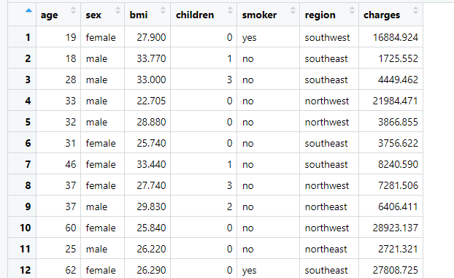

Slide 5
Overview
In this data analysis project, we will conduct an Exploratory Data Analysis (EDA) on the "Medical Cost Personal Datasets." The dataset contains information about various individuals' medical costs and factors that may influence those costs. This project aims to gain insights into the data, understand patterns, and uncover relationships between variables.

Slide 6
Tools and Libraries:
We will be using the R programming language for the data analysis and visualization. The following R libraries will be utilized throughout the project:
tidyverse: For data manipulation and visualization.
ggplot2: For creating various types of data visualizations.
caret: For building predictive models.
Project Scope:
This project will explore the dataset and draw meaningful insights related to medical costs. We will not delve into advanced modelling or predictive accuracy. The emphasis is on understanding the data and its characteristics.

Slide 7
Data Visualization

Slide 8
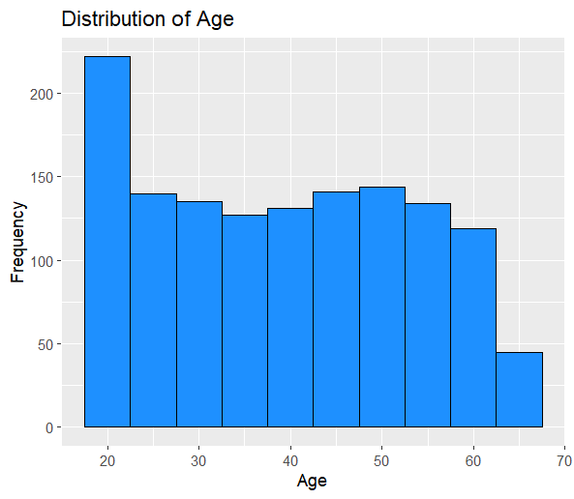
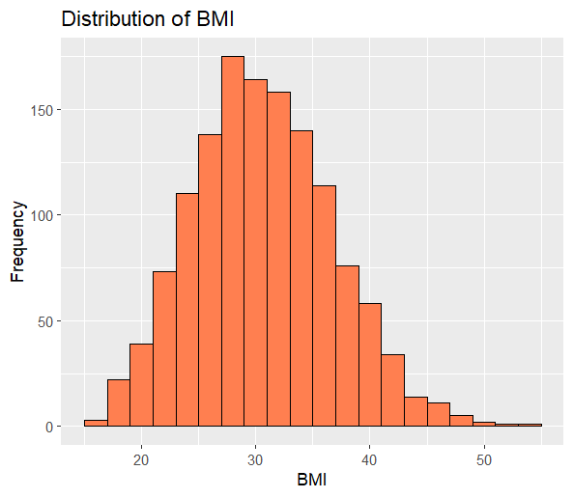
Graphs
Histogram of Age
Histogram of BMI

Slide 9
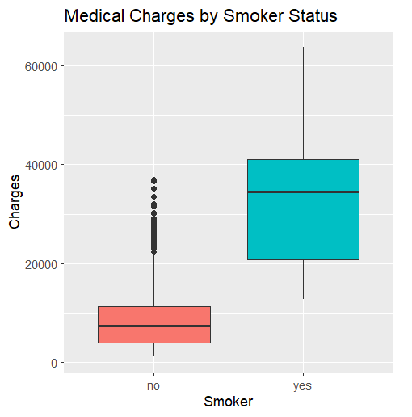
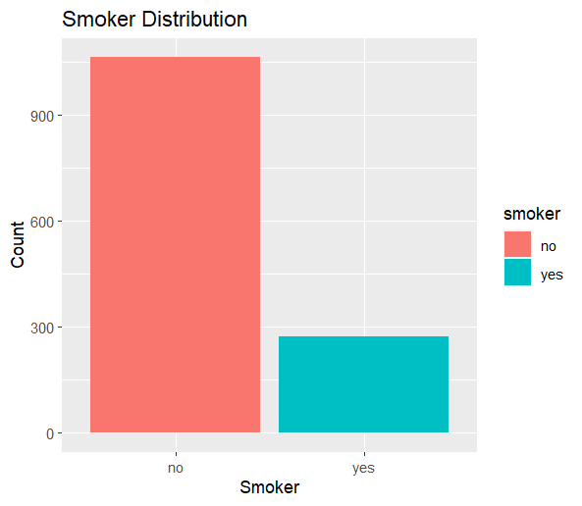

Slide 10
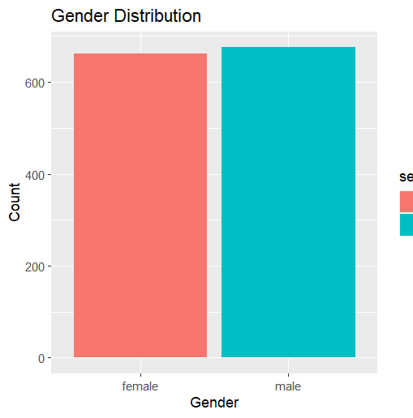
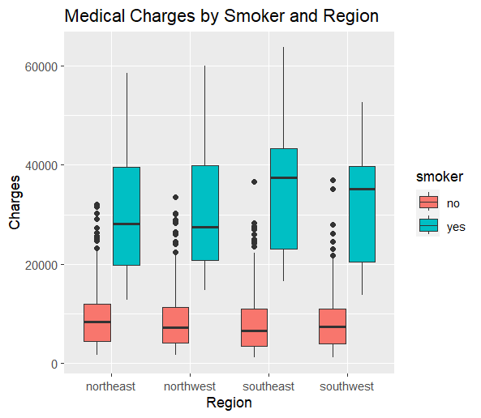

Slide 11
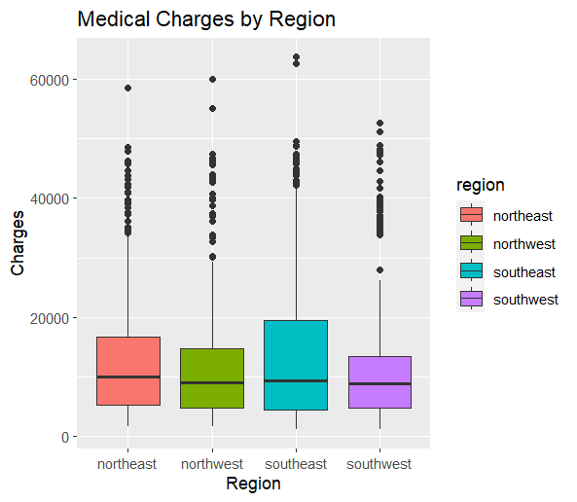
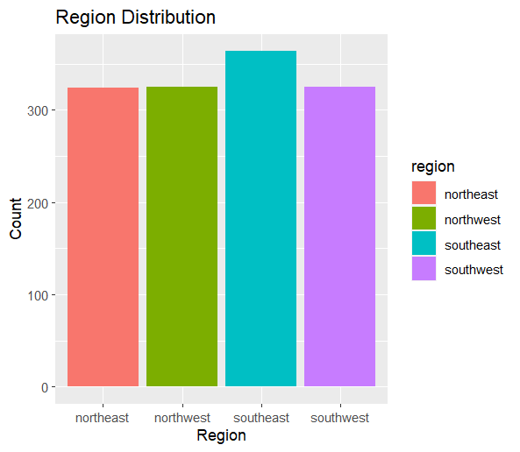

Slide 12
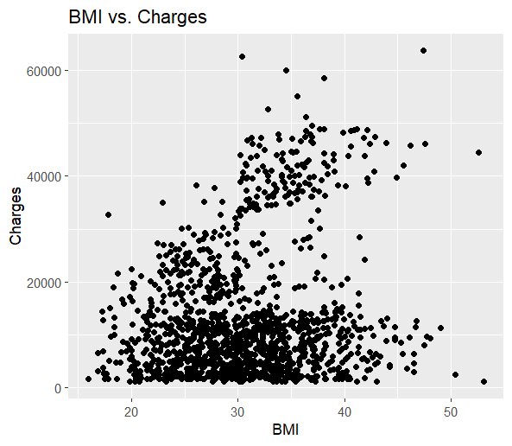
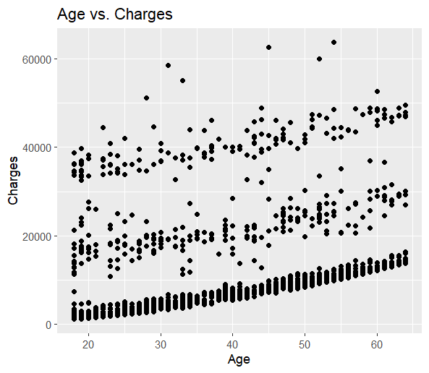

Slide 13
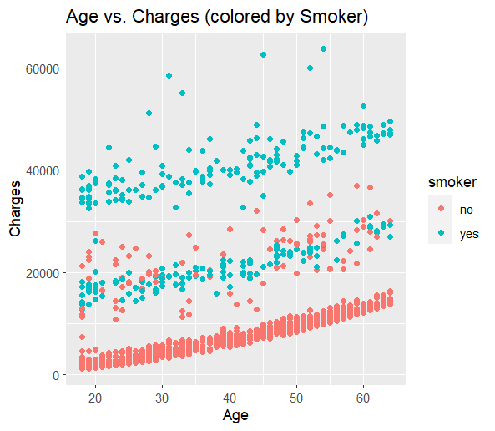

Slide 14
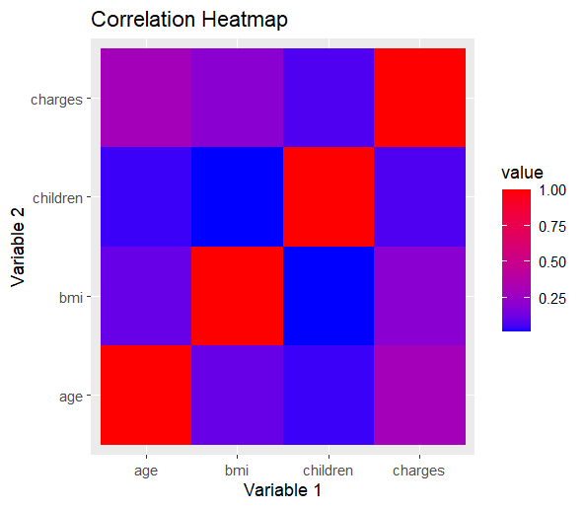
CORRELATION ANALYSIS

Slide 15
Based on the insights from our initial exploration, we can proceed with more in-depth analysis and even build predictive models to estimate medical costs based on different attributes. We may also want to handle missing data, perform feature engineering, and conduct statistical tests to validate any observed relationships. This will allow us to gain a deeper understanding of the factors influencing medical costs and make more accurate predictions in the future. By continuously refining our analysis and models, we can provide valuable insights for decision-making and improve the overall healthcare system's efficiency and effectiveness.

Slide 16
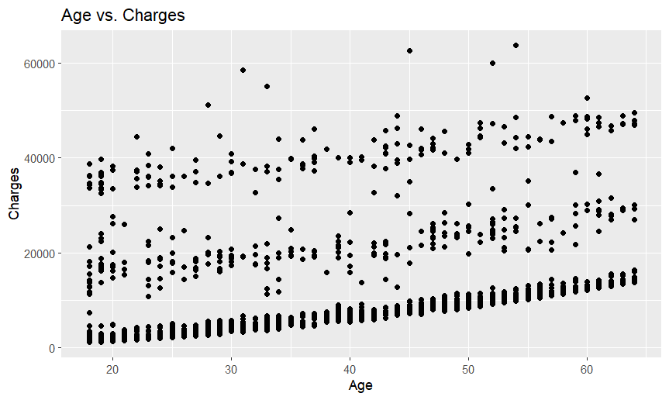
Analyzing Relationships
Scatter plot of Age vs. Charges

Slide 17
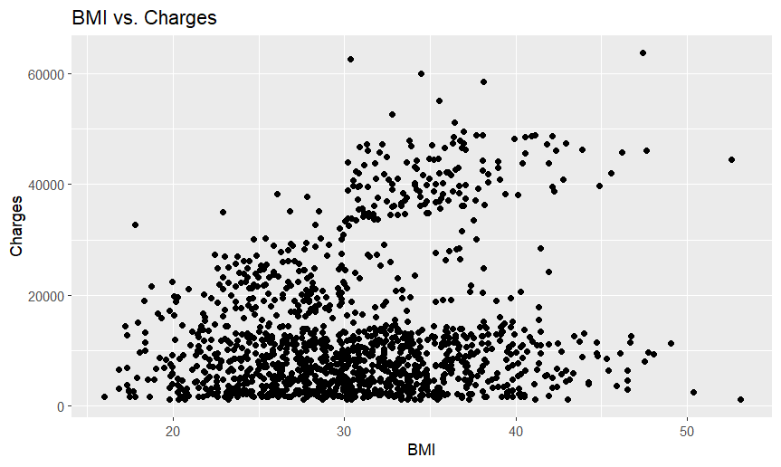
Scatter plot of BMI vs. Charges

Slide 18
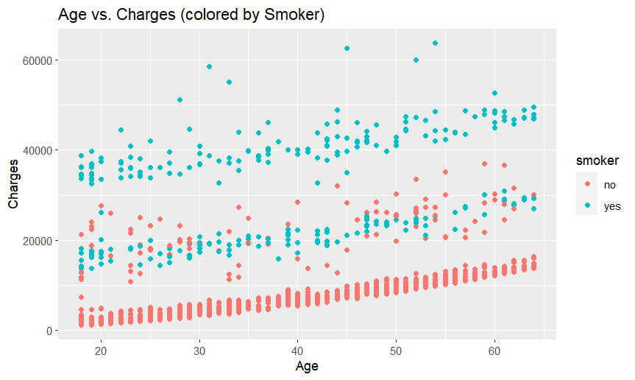
Scatter plot of Age vs. Charges colored by Smoker status

Slide 19
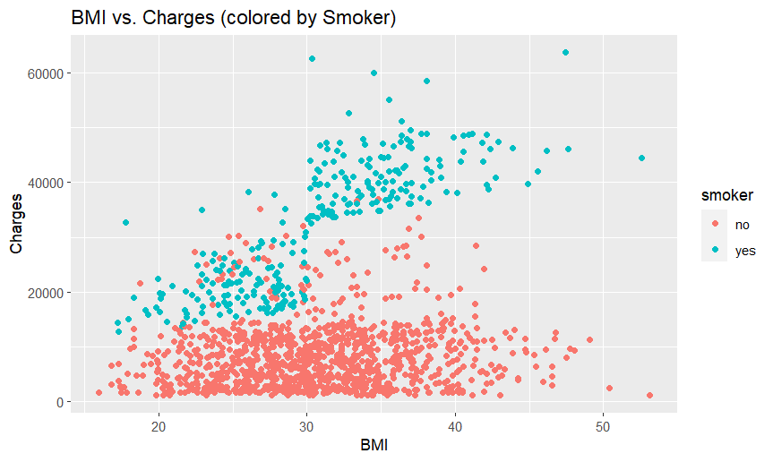
Scatter plot of BMI vs. Charges colored by Smoker status

Slide 20
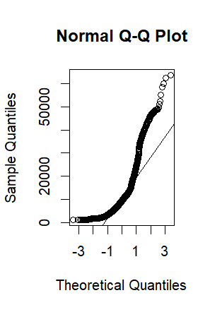
QQ PLOTS
The Q-Q plot is used to check the normality of the 'charges' variable, which is essential for linear regression assumptions.
If the data points on the Q-Q plot fall close to the diagonal line, it suggests that the 'charges' variable follows a normal distribution.
Deviations from the diagonal line indicate departures from normality, which may affect the reliability of statistical tests that assume normality.

Slide 21

hypothesis test to compare medical charges between smokers and non-smokers
Hypothesis testing is a statistical method used to make inferences about a population based on sample data. It helps us determine whether a claim or hypothesis about the population is supported by the data or not
t-test: Used to compare the means of two groups.
ANOVA (Analysis of Variance): Used to compare means of multiple groups.

Slide 22
A hypothesis test to compare medical charges between smokers and non-smokers
t_test_result <- t.test(charges ~ smoker, data = medical_data)
t_test_result
Welch Two Sample t-test
data: charges by smoker
t = -32.752, df = 311.85, p-value < 2.2e-16
alternative hypothesis: true difference in means between group no and group yes is not equal to 0
95 percent confidence interval:
-25034.71 -22197.21
sample estimates:
mean in group no mean in group yes
8434.268 32050.232

Slide 23
Null Hypothesis (H0): There is no significant difference in medical charges between different groups based on the attribute under investigation. In other words, the mean medical charges are equal across all categories of the variable being tested.
Alternative Hypothesis (H1): There is a significant difference in medical charges between at least two groups based on the attribute under investigation. In other words, the mean medical charges are not equal across all categories of the variable being tested.
For example:
Hypothesis test for medical charges between smokers and non-smokers:
H0: The mean medical charges of smokers and non-smokers are equal.
H1: The mean medical charges of smokers and non-smokers are not equal.
Hypothesis test for medical charges between different regions:
H0: The mean medical charges are equal across all regions.
H1: The mean medical charges are not equal across all regions.
Hypothesis test for medical charges between males and females:
H0: The mean medical charges for males and females are equal.
H1: The mean medical charges for males and females are not equal.

Slide 24
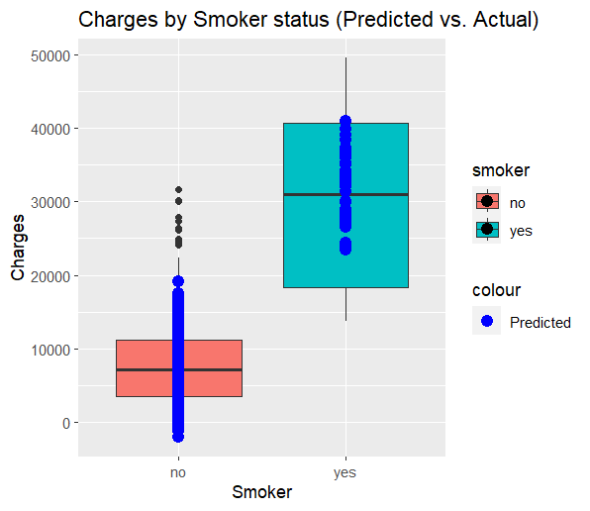
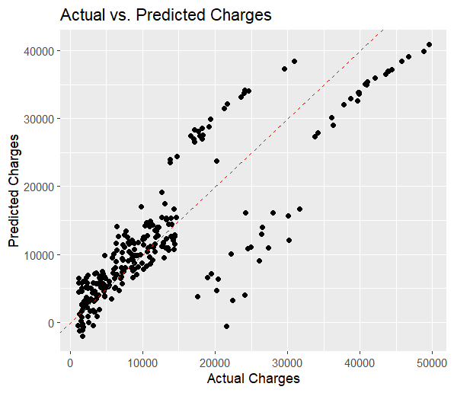
Model Interpretation and Visualization

Slide 25
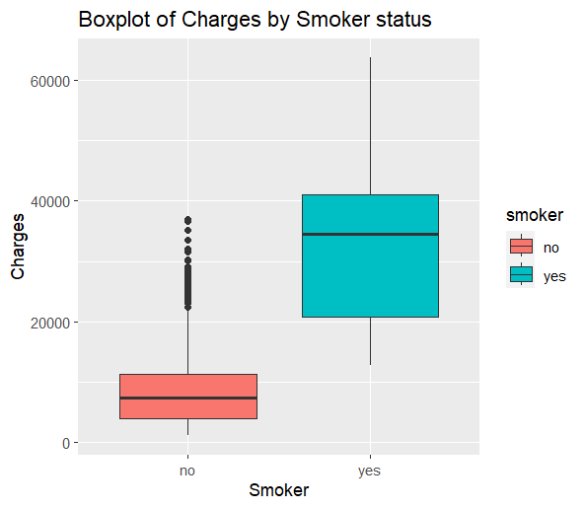
Boxplots for
T-test

Slide 26
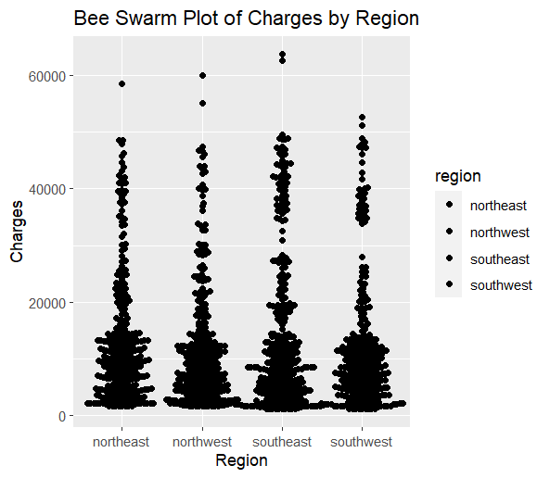
Bee Swarm Plot for ANOVA (Analysis of Variance)

Slide 27
Regression (Linear Regression)
Coefficients:
Estimate Std. Error t value Pr(>|t|)
(Intercept) 3165.9 937.1 3.378 0.000751 ***
age 257.7 22.5 11.453 < 2e-16 ***
---
Signif. codes: 0 ‘***’ 0.001 ‘**’ 0.01 ‘*’ 0.05 ‘.’ 0.1 ‘ ’ 1
Residual standard error: 11560 on 1336 degrees of freedom
Multiple R-squared: 0.08941, Adjusted R-squared: 0.08872
F-statistic: 131.2 on 1 and 1336 DF, p-value: < 2.2e-16
# Fit a linear regression model to predict charges based on age
lm_model <- lm(charges ~ age, data = medical_data)
summary(lm_model)
Call:
lm(formula = charges ~ age, data = medical_data)
Residuals:
Min 1Q Median 3Q Max
-8059 -6671 -5939 5440 47829

Slide 28
Residuals:
Min 1Q Median 3Q Max
-11304.9 -2848.1 -982.1 1393.9 29992.8
Coefficients:
Estimate Std. Error t value Pr(>|t|)
(Intercept) -11938.5 987.8 -12.086 < 2e-16 ***
age 256.9 11.9 21.587 < 2e-16 ***
bmi 339.2 28.6 11.860 < 2e-16 ***
children 475.5 137.8 3.451 0.000577 ***
smokeryes 23848.5 413.1 57.723 < 2e-16 ***
sexmale -131.3 332.9 -0.394 0.693348
regionnorthwest -353.0 476.3 -0.741 0.458769
regionsoutheast -1035.0 478.7 -2.162 0.030782 *
regionsouthwest -960.0 477.9 -2.009 0.044765 *
Signif. codes: 0 ‘***’ 0.001 ‘**’ 0.01 ‘*’ 0.05 ‘.’ 0.1 ‘ ’ 1
Residual standard error: 6062 on 1329 degrees of freedom
Multiple R-squared: 0.7509, Adjusted R-squared: 0.7494
F-statistic: 500.8 on 8 and 1329 DF, p-value: < 2.2e-16
Multi-linear Regression
# Fit a multi-linear regression model to predict charges using multiple predictors
multi_lm_model <- lm(charges ~ age + bmi + children + smoker + sex + region, data = medical_data)
summary(multi_lm_model)
Call:
lm(formula = charges ~ age + bmi + children + smoker + sex +
region, data = medical_data)

Slide 29
Logistic Regression
Coefficients:
Estimate Std. Error z value Pr(>|z|)
(Intercept) -2.943e+00 3.986e-01 -7.384 1.53e-13 ***
age -8.615e-02 1.064e-02 -8.099 5.54e-16 ***
charges 2.948e-04 1.925e-05 15.316 < 2e-16 ***
---
Signif. codes: 0 ‘***’ 0.001 ‘**’ 0.01 ‘*’ 0.05 ‘.’ 0.1 ‘ ’ 1
(Dispersion parameter for binomial family taken to be 1)
Null deviance: 1356.63 on 1337 degrees of freedom
Residual deviance: 420.33 on 1335 degrees of freedom
Akaike information criterion (AIC): 426.33
Number of Fisher Scoring iterations: 7
# Fit a logistic regression model to predict smoker status based on age and charges
logistic_model <- glm(smoker ~ age + charges, data = medical_data, family = "binomial")
summary(logistic_model)
Call:
glm(formula = smoker ~ age + charges, family = "binomial", data = medical_data)

Slide 30
In my opinion, for the given project, choosing the best regression model depends on the specific objectives and context. Linear regression offers interpretability, multiple linear regression accounts for multiple predictors, and logistic regression is well-suited for binary classification. My final decision would consider factors such as interpretability, predictive accuracy, and alignment with the research question.

Slide 31
Suggestions for the Project:
Smoking Cessation Programs: Considering the significant impact of smoking on medical charges, healthcare providers and policymakers should invest in smoking cessation programs and resources. These interventions can help reduce the financial burden on individuals and the healthcare system while improving overall health outcomes.
Regional Healthcare Policies: Addressing regional variations in medical charges requires tailored healthcare policies and initiatives. Identifying and targeting regions with higher medical charges can lead to more efficient resource allocation and improved access to affordable healthcare services.

